Slide 1
MEMORY NUMERA YOUNUS

Slide 2

OBJECTIVE
Defining the main stages of memory, and types of memory
Explaining sensory, short term, and long term memory
Discussing how we forget information and remembering processes

Slide 3
Memory
Memory is the process by which information is encoded, stored, and retrieved.
Memory is the term given to the structures and processes involved in the storage and retrieval of information.

Slide 4
Human Memory is Good at
Information on which attention is focused
Information in which we are interested
Information that arouses us emotionally
Information that fits with our previous experiences
Information that we rehearse

Slide 5
The Process

Slide 6
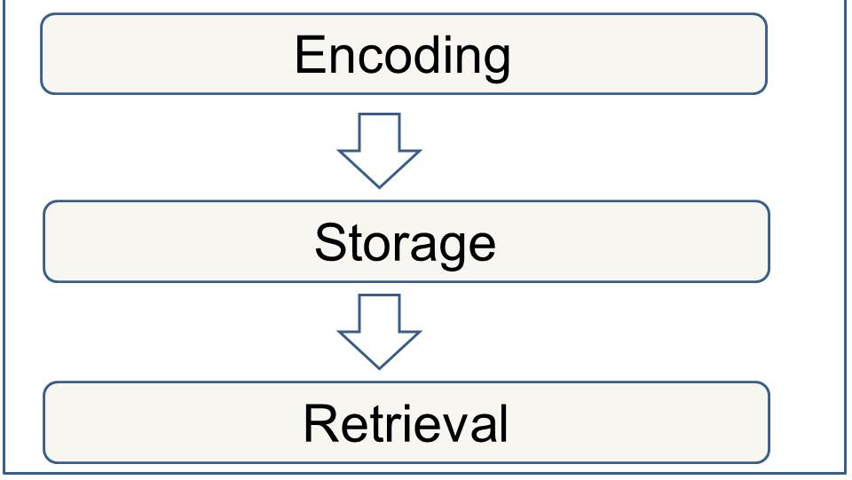
Processes of Memory

Slide 7
Processes of Memory
Encoding
Storage
Access and Retrieval
Involves modification of information to fit the preferred format of the memory system
Elaboration – Type of encoding in which meaning is added to information in working memory so that it may be more easily stored and retrieved

Slide 8
Processes of Memory
Encoding
Storage
Access and Retrieval
Involves retention of encoded material over time

Slide 9
Processes of Memory
Encoding
Storage
Access and Retrieval
Involves the location and recovery of information from memory

Slide 10
Atkinson and Shiffrin Modal Model
The multistore model of memory (also known as the modal model) was proposed by Atkinson and Shiffrin (1968) and is a structural model. They proposed that memory consisted of three stores:
Sensory register
Short-term memory (STM)
Long-term memory (LTM)

Slide 11
Stages of Memory

Slide 12
Stages of Memory
Sensory Memory
Working Memory
Long-term Memory

Slide 13
Stages of Memory
Sensory Memory
Working Memory
Long-term Memory
Preserves brief sensory impressions of stimuli, also called sensory register

Slide 14
Sensory Memory
Preserves brief sensory impressions of stimuli, also called sensory register
The very first stage of memory. The point at which information enters the nervous system through the sensory system
Duration
¼ to ½ second
Capacity
all sensory experience
Encoding
sense specific (e.g. different stores for each sense)

Slide 15
Sensory Memory
The sensory register is a memory system that works for a very brief period of time that stores a record of information until the information is selected for further processing or discarded.
In other words, storing an exact copy of incoming information for a few seconds
The sensory memory register is specific to individual senses:
Iconic memory for visual information
Echoic memory for auditory information
Haptic Memory for touch
Sensory memory operates pre-attentively (sub-consciously)

Slide 16
Stages of Memory
Sensory Memory
Working Memory
Long-term Memory
Preserves recently perceived events or experiences for less than a minute without rehearsal, also called short-term memory or STM

Slide 17
Working memory / Short-term Memory
Holds small amounts of information briefly
0-18 seconds.
Capacity: Magic number 7! 7 +/- 2 items
STM is susceptible to interference
e.g., if counting is interrupted, have to start over
Selective Attention: Focusing (voluntarily) on a selected portion of sensory input (e.g., selective hearing)

Slide 18
Working memory / Short-term Memory
Chunking is the organization of items into familiar or manageable units or chunks.
Remember the following letters
PBSFOXBETABCCBS
Recall as many letters as you can

Slide 19
Remember the following letters
PBS FOX BET ABC CBS
Recall as many letters as you can

Slide 20
Maintenance rehearsal
Process in which information is repeated or reviewed to keep it from fading while in working memory
Elaborative rehearsal
Process in which information is actively reviewed and related to information already in LTM
Acoustic encoding
Conversion of information to sound patterns in working memory
Learning the alphabet or multiplication tables can be an example of acoustic.

Slide 21
Stages of Memory
Sensory Memory
Working Memory
Long-term Memory
Stores material organized according to meaning, also called LTM

Slide 22
Long-term Memory
The information processing model posits that long-term memory is a system that encodes, stores, and retrieves information
Information can only be stored for a lifetime in LTM.
Three types of Memory
Procedural Nondeclarative
Semantic
Episodic Declarative

Slide 23
Types of Memory
Declarative
Declarative memory refers to memories which can be consciously recalled such as facts and knowledge. Hippocampus plays a major role in Declarative memory
Declarative memory can be divided into two categories:
Episodic memory
Semantic memory
Non declarative
Refers to unconscious memories for highly practiced skills for example Procedural memory that involves skills (e.g. learning to ride a bicycle)

Slide 24
Procedural memory
Part of the long-term memory is responsible for knowing how to do things, i.e. memory of motor skills.
Semantic memory
Part of the long-term memory responsible for storing information about the world.
Episodic memory
Part of the long-term memory responsible for storing information about events (i.e. episodes) that we have experienced in our lives.
It does not involve conscious (i.e. it’s unconscious - automatic) thought and is not declarative.
For example, procedural memory would involve knowledge of how to ride a bicycle.
This includes knowledge about the meaning of words, as well as general knowledge.
It involves conscious thought and is declarative.
For example, London is the capital of England.
It involves conscious thought and is declarative.
An example would be a memory of our 1st day at school.

Slide 25
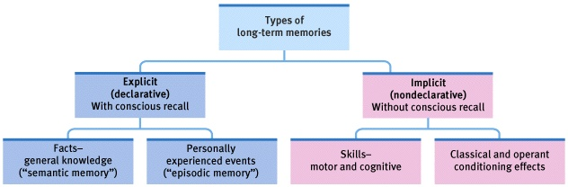
Long Term Memory

Slide 26
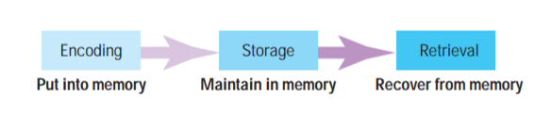
Stages of Memory
When information comes into our memory system (from sensory input), it needs to be changed into a form that the system can cope with, so that it can be stored. (Converting information into a useable form)
This concerns the nature of memory stores, i.e., where the information is stored, how long the memory lasts for (duration), how much can be stored at any time (capacity) and what kind of information is held.
Retrieval is the process of getting (“retrieving”) information out of memory storage.

Slide 27
How do we Retrieve Memories
Whether memories are implicit or explicit, successful retrieval depends on how they were encoded and how they are cued
Implicit memory
Memory that was not deliberately learned or of which you have no conscious awareness
Explicit memory
Memory that has been processed with attention and can be consciously recalled

Slide 28
Retrieving Implicit Memory
Priming
Technique for retrieving implicit memories by providing cues that stimulate a memory without awareness of the connection between the cue and the retrieved memory

Slide 29
Priming
If you are presented with the following words:
assassin, octopus, avocado, mystery, sheriff, climate

Slide 30
Priming
An hour later, you would easily be able to identify which of the following words you had previously seen
twilight, assassin, dinosaur, mystery

Slide 31
Priming
However, an hour later, you would also have a much easier time filling in the blanks of some of these words than others:
ch_ _ _ _ nk
o _ t _ _ _ us
_ _ y _ h _ _ _ g _
_ l _ m _ te

Slide 32
Priming
While you did not actively try to remember “octopus” and “climate” from the first list, they were primed in the reading, which made them easier to identify in this task
chipmunk
octopus
bogeyman
climate

Slide 33
Retrieving Explicit Memories
Anything stored in LTM must be filed according to its pattern or meaning

Slide 34
Recall
Technique for retrieving explicit memories in which one must reproduce previously presented information
Example: essay test
Recognition
Technique for retrieving explicit memories in which one must identify present stimuli as having been previously presented
Example: multiple-choice test

Slide 35
Other Factors Affecting Retrieval
Encoding specificity principle
The more closely the retrieval clues match the form in which the information was encoded, the better the information will be remembered
Shows how memories are linked to the context where they are created
State/mood congruent memory
Formed during a particular physiological or psychological state will be easier to recall while in similar state

Slide 36
Forgetting
Interference, which occurs when some information blocks or disrupts the recall of other information, is believed to be a primary source of forgetting.
Forgetting Curve
Ebbinghaus - series of tests on himself
Memorization and forgetting of meaningless three letter words.
Nonsense words such as “WID”, “ZOF and “KAF”
Check if information is retained after different time periods.
The results thus obtained were plotted in a graph, which is now referred to as the forgetting curve.

Slide 37
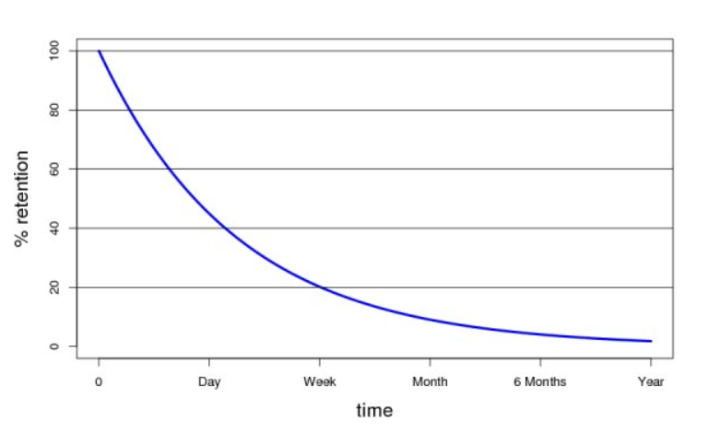
Memory retention is 100% at the time of learning any particular piece of information. However, it drops rapidly to 40% within the first dew days. After which, the declination of memory retention slows down again and Memory Decays.

Slide 38
Theories of forgetting
Decay theory
Memory traces fade with time but decay does not appear to be a factor in LTM.
Interference theory
People forget information because of competition from other material.
Repressed memories
Retrieval failure
Controversy about repressed traumatic memories and link with clinical suggestion.

Slide 39
Why we Forget
Repression
Suppression
Brain tumor
Diseases of the nervous system
Old age
Accidental injuries
Organic Decay
Those traces which do not get reinforced by training and practice, will fade away with time.
Retroactive Inhibition (Interference)
Proactive Inhibition (Interference)

Slide 40
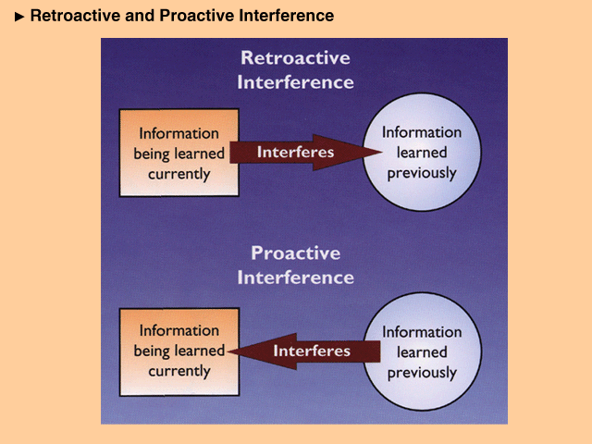

Slide 41
How to improve memory

Slide 42
Chunking
Elaborative Rehearsals
Study repeatedly ( over learning)
Organize material
Think and be sure that you understand the meaning of the material to be memorized
Establish memory cues (imagery can be useful)
PQRST
P= Preview
Q= Question
R= Read
S= Self recitation
T= Test

Slide 43
Eyewitness Testimony… Is it Reliable?
Witnesses reconstruct memory
Time gap
Focus of eyewitness
Can form false memories

Slide 44
Pervasive Role of Memory in Everyday Life
Write down everything you did yesterday that did NOT involve memory
Blinking, Burping, Seeing, Breathing, Sleeping, Waking Up
Walking, Using The Bathroom, Eating, Talking, Working
Memory Loss
Amnesia
Dementia
Alzhiemers

Slide 45

Thank you Any Question?

